Slide 1

Telecom Customer Churn Prediction
-t.Nikitha reddy
-h.manasa
-a.bhavya sri
-b.varun kumar

Slide 2
INTRODUCTION
Telecom Customer Churn Prediction involves using machine learning algorithms to forecast which customers are likely to leave a telecom service provider. By analyzing historical data such as customer demographics, usage patterns, and customer service interactions, predictive models can be built to identify potential churners. Techniques like logistic regression, decision trees, or neural networks can be employed for this task. The goal is to proactively address customer issues and prevent churn by offering targeted incentives or personalized services. This predictive analysis helps telecom companies optimize customer retention strategies and improve overall customer satisfaction.

Slide 3
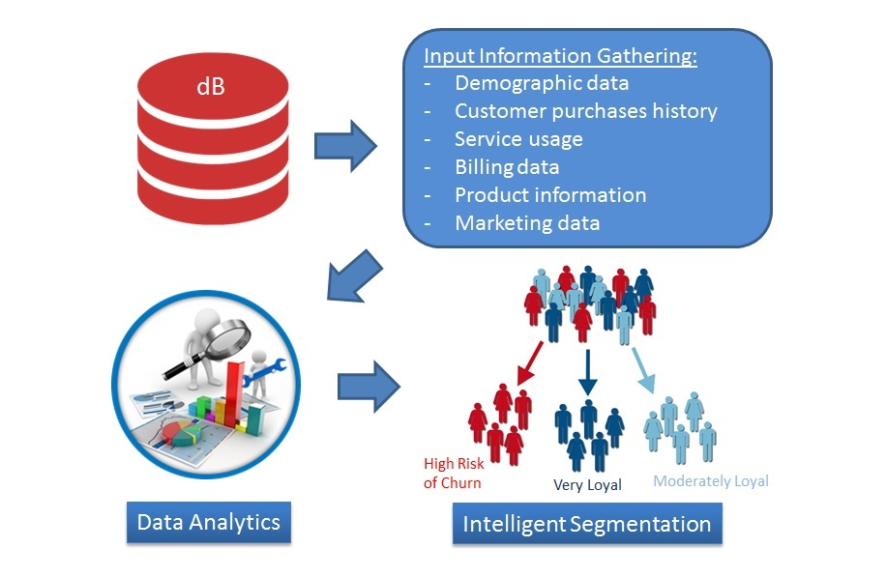
Methodology
In Telecom Customer Churn Prediction, various methodologies can be employed, including machine learning algorithms like Logistic Regression, Decision Trees, Random Forest, and Neural Networks. The process typically involves data preprocessing, feature selection, model training, evaluation, and deployment. Feature engineering plays a crucial role in extracting meaningful insights from customer data.

Slide 4
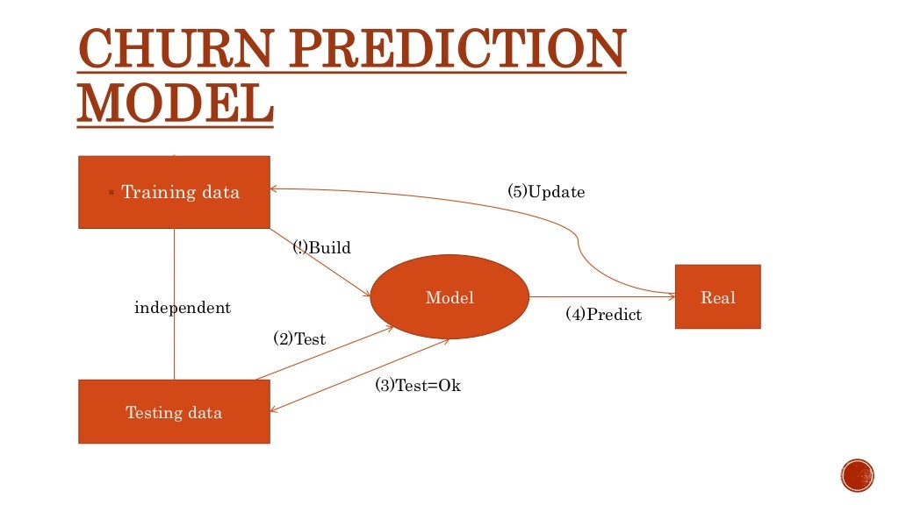
Technologies
In Telecom Customer Churn Prediction, various technologies play a crucial role in analyzing and predicting customer behavior. Machine learning algorithms such as Logistic Regression, Random Forest, and Gradient Boosting are commonly employed to process large datasets and identify patterns indicative of potential churn. Additionally, tools like Python with libraries such as Scikit-learn and TensorFlow are popular choices for implementing these algorithms efficiently. Furthermore, the use of Big Data technologies like Apache Hadoop and Spark enables handling vast amounts of data for accurate predictions.

Slide 5
Advantages
Reduced Customer Attrition: By predicting which customers are likely to churn, telecom companies can proactively take steps to retain them, thus reducing overall customer attrition rates.
Enhanced Customer Retention Strategies: Insights from churn prediction models enable companies to tailor retention strategies for different customer segments, improving customer satisfaction and loyalty.
Cost Savings: Identifying potential churners allows companies to focus their resources on retaining high-value customers, leading to cost savings in the long run.
Improved Marketing Campaigns: Churn prediction models help in targeting marketing campaigns more effectively by directing efforts towards customers at risk of leaving.

Slide 6
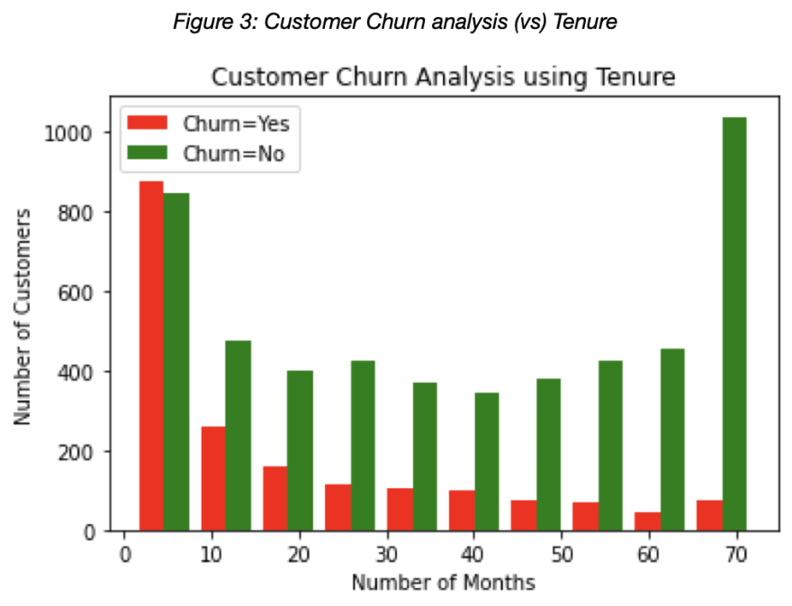
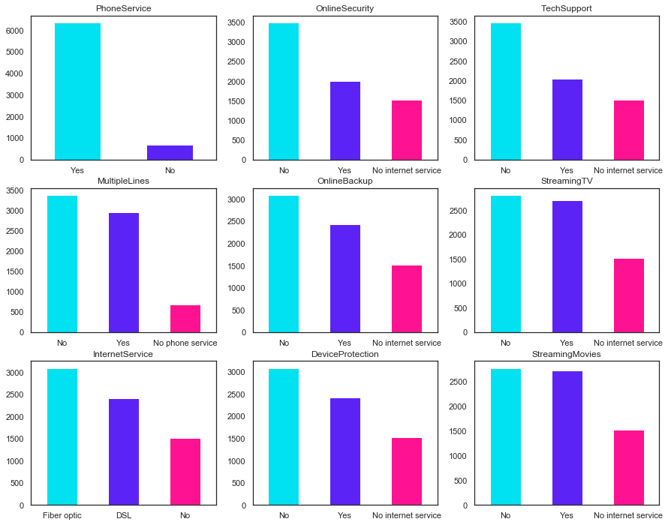

Slide 7
Conclusion
In conclusion, Telecom Customer Churn Prediction is a critical aspect of customer retention strategies in the telecommunications industry. By leveraging machine learning algorithms and predictive analytics, telecom companies can forecast customer churn with high accuracy. The insights gained from these predictions enable companies to proactively address customer issues, personalize offerings, and implement targeted retention campaigns. Ultimately, the goal is to reduce churn rates, enhance customer satisfaction, and improve overall business performance. Continuous monitoring and refinement of churn prediction models are essential to adapt to changing customer behaviors and market dynamics effectively.

Slide 8


